Slide 1
9. Naïve Bayesian Classifier
Youngsoo Kim <pineland@hanmail.net>
Code : https://github.com/pineland/AIDA/

Slide 2
Contents
Introduction to Bayesian Classification
Bayes Theorem
Naïve Bayes Classifier
Classification Example
Text Classification – an Application
Comparison with other classifiers
Advantages and disadvantages
Conclusions

Slide 3
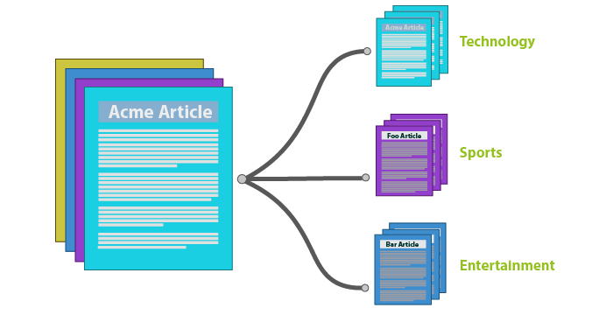
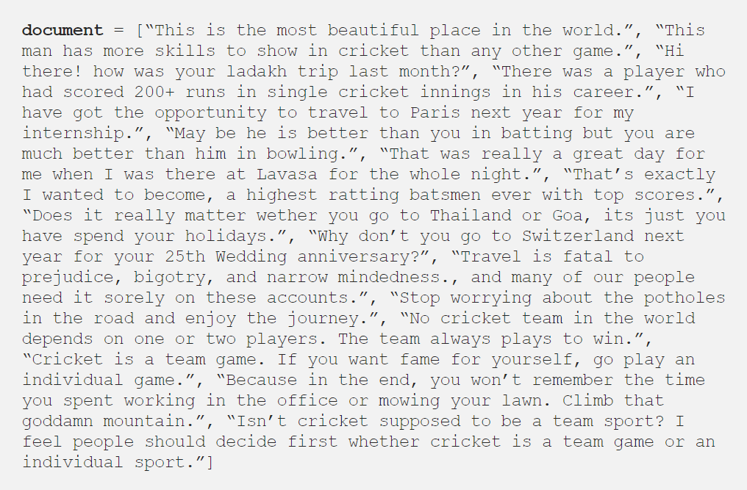
How to classify text documents?

Slide 4
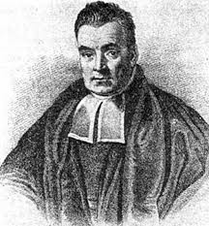
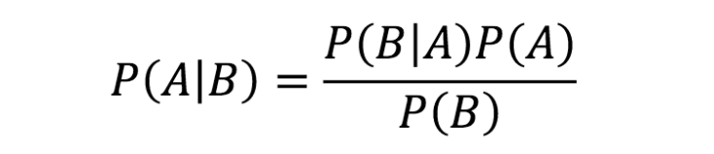
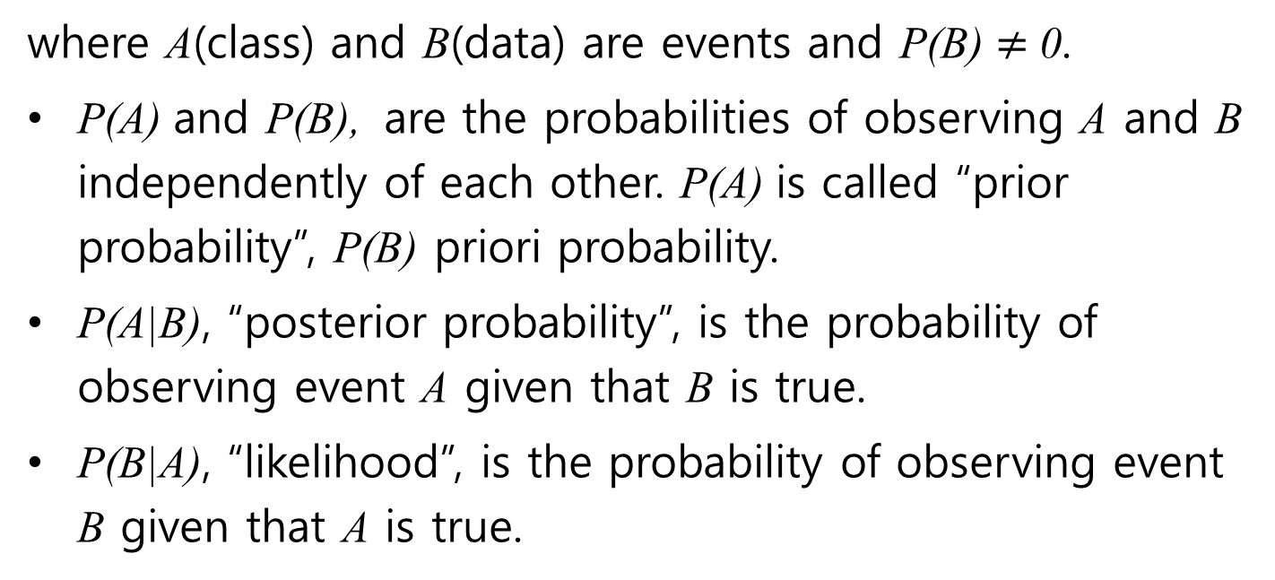
Bayes theorem
Reverend Thomas Bayes
(1702 - 1761)
where A(class) and B(data) are events and P(B) $≠$ 0.
P(A) and P(B), are the probabilities of observing A and B independently of each other. P(A) is called “prior probability”, P(B) priori probability.
P(A|B), “posterior probability”, is the probability of observing event A given that B is true.
P(B|A), “likelihood”, is the probability of observing event B given that A is true.

Slide 5
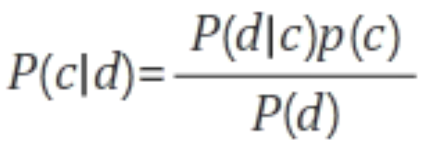
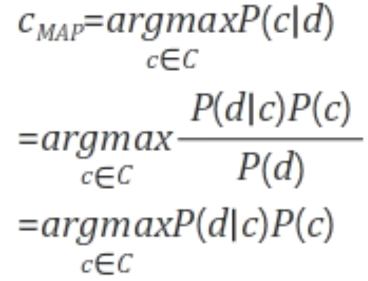
Naïve Bayes classifier(1)
Let's d is an input document and c is one of the classes to classify, it can be represented as follows according to the Bayesian Rule:
The document d will be classified into a class c_{MAP} with the highest probability for the given document.
Notes:
* https://unlimitedpower.tistory.com/entry/NLP-Naive-Bayesian-Classification%EB%82%98%EC%9D%B4%EB%B8%8C-%EB%B2%A0%EC%9D%B4%EC%A6%88-%EB%B6%84%EB%A5%98

Slide 6
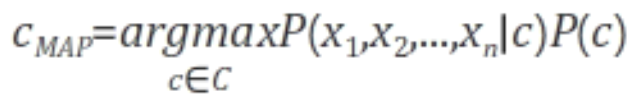
Naïve Bayes classifier(2)
When the input document (d) is composed of several words (x₁, x₂, ..., x_{n}). P(d|c) can be modified as follows:
By adding the assumption that each word is independent of the class, we can easily classify the document by easily calculating the transformed conditional probabilities as follows:
☞ Bayes classifier

Slide 7

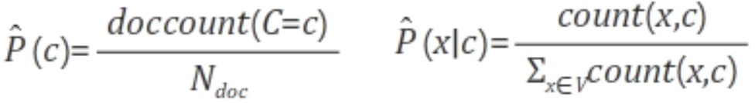
Naïve Bayes classifier(3)
Therefore, the final naive Bayesian classification is:
P(c) and P(x|c) can simply be calculated as frequency.
☞ Naïve Bayes classifier

Slide 8
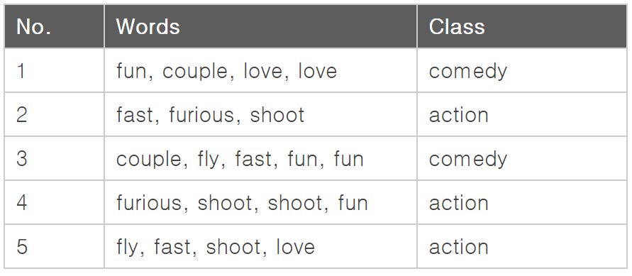

Example of Naïve Bayes classifier
Let's there are five documents, and two classes, comedy and action as follows.
Let's calculate which category the document belongs to when the input document is:

Slide 9
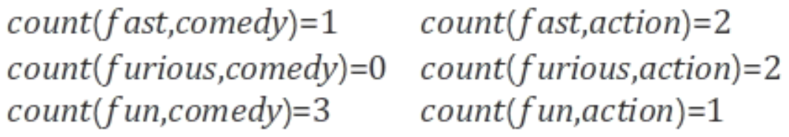
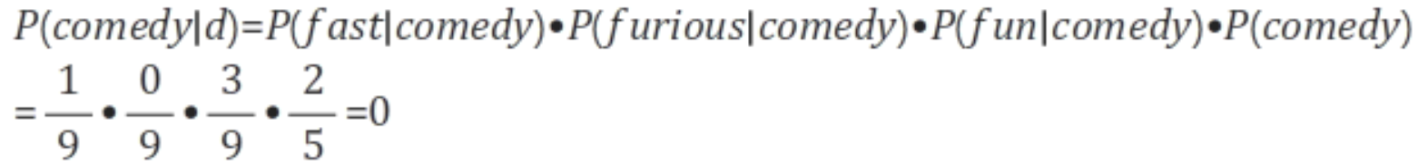
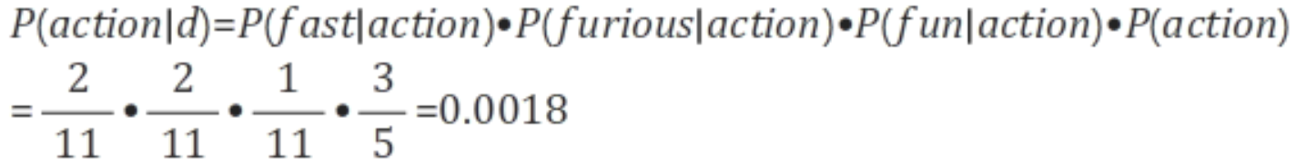
First, calculate the frequency of each class and word.
Calculate probabilities using the above equations.
Since the probability for the “action” class is higher,
the document is classified as an “action”.

Slide 10
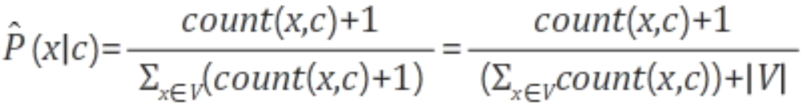
Laplace Smoothing
Problem definition
If a new word comes out that is not in the training dataset, all of the probabilities are zero.
One solution
The most commonly used is “Laplace (add-1) Smoothing”.
where |V| is the number of unique words, not the
total number of words.

Slide 11
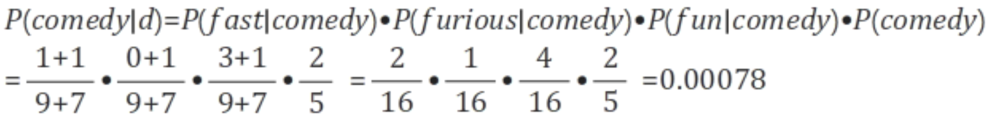
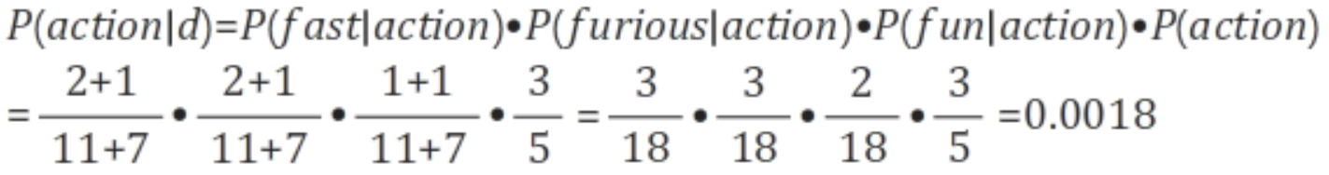

Each classification probability is calculated by applying Laplace Smoothing and the results are as follows:
Laplace smoothing solves the problem of zero prob.
The document is still classified as “the action” because of the high probability of the action class.
<Ref> As the number of words in an input document increases, the probabilities can be significantly lower, which can make a comparison difficult.
Use a log on the probability as follows:

Slide 12
Applications of Naïve Bayes classifier
Text / Document Classification
Top secret, Secret, Confidential paper
Classify web pages by topic
Spam Filtering
Information Retrieval system
Recommender system

Slide 13
Procedure of Naïve Bayes classifier
Build the vocabulary as the list of all distinct words that appear in all the documents of the training set.
Remove stop words and markings.
While each document in the training set becomes a record the words in the vocabulary become the attributes.
Train the classifier based on the training data set, by calculating the prior probabilities for each class and attributes.
Evaluate the results on the test dataset.

Slide 14
Advantages and disadvantages of naïve Bayes
Advantages
Easy to implement
Requires a small amount of training data to estimate the parameters
Good results obtained in most of the cases
Disadvantages
Assumption: class conditional independence. Practically, dependencies exist among variables.
therefore loss of accuracy

Slide 15
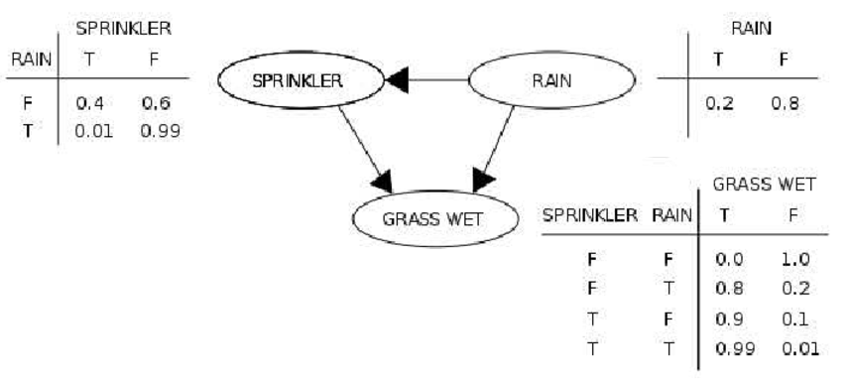
Variants of naïve Bayes classifier
Bayesian belief network
Graphical models, which unlike naïve Bayesian classifiers, allow the representation of dependencies among subsets of attributes.

Slide 16

Q & A

